Slide 1
VGG-16
VGG-FACE
CNN
RESNET50
SENET50

Slide 2
LENET
ALEXNET
VGGNET
(VGG16, VGG19)
2014
CONV-MAXPOOL
CONV-CONV
CONV-CONV-CONV

Slide 3
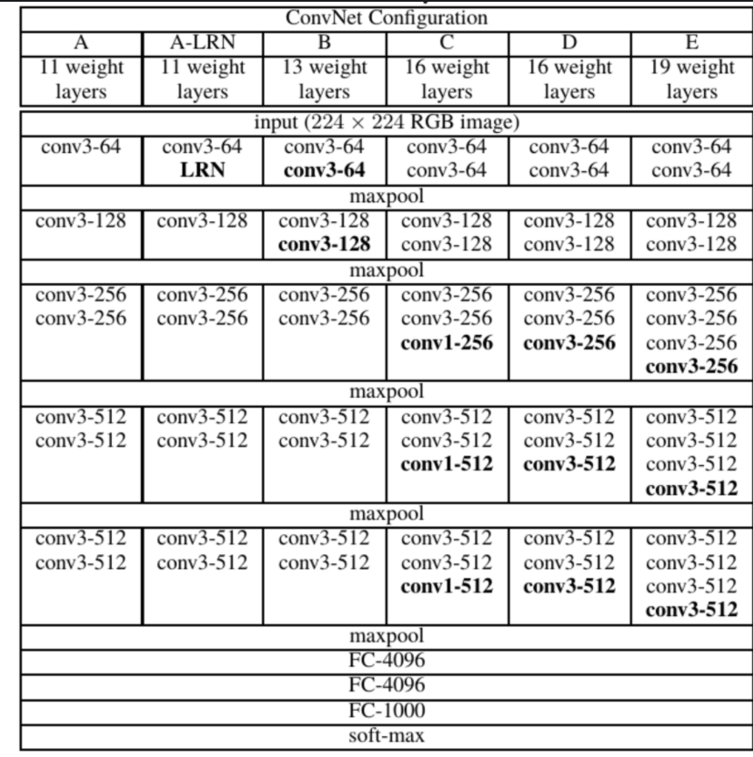
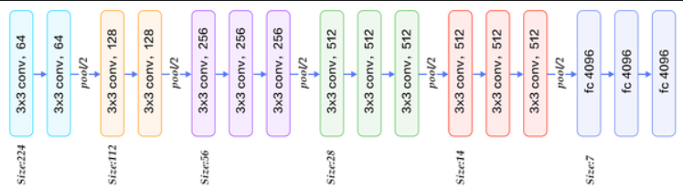

Slide 4
